Slide 1


Introduction
In this tutorial I will explain how to deploy an application which is built using Docker. As an example we will deploy a very simple Airflow application.
You can very quickly create such an application by following this tutorial: www.youtube.com.

Slide 2
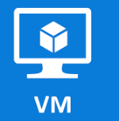



Introduction
We will create an Azure Linux Virtual Machine and a CI/CD pipeline in Azure DevOps which is automatically taking code from repository once we push code to it and run that code on the created VM.
Push code to a repository
Run code on a VM

Slide 3



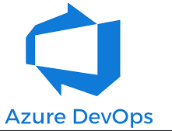
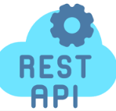
Technologies used
The main technologies which we will be using are:
Terraform
Docker
Python
Rest API
Azure
Azure DevOps

Slide 4
Recommended materials to learn those technologies
Here are the recommended materials to learn technologies used in this tutorial:
Terraform
High level overview - www.youtube.com
Install and start using Terraform - developer.hashicorp.com
Detailed tutorial - www.youtube.com
2. Docker
High level overview - www.youtube.com
More detailed tutorials:
www.youtube.com
docs.docker.com
3. Python
Detailed tutorial - www.youtube.com
VENV - www.youtube.com
4. Rest API with Python
Detailed tutorial - www.youtube.com

Slide 5
Requirements
In order to follow this tutorial you need:
Azure subscription
Azure DevOps project set up
Terraform and Python installed

Slide 6
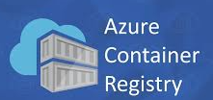
CI/CD pipeline design
Pull Docker image onto a VM and run it.
Push Docker image to ACR
Take code from repository
Build Docker image

Slide 7
CI/CD pipeline preparation steps
Before we create and run a CI/CD pipeline we need to prepare some infrastructure in Azure and Azure DevOps:
Create an Agent pool in DevOps
Create and configure an Azure Linux VM
Create an Azure Container Registry (ACR)
Create a Variable group and Service connection in DevOps
Generate a proper YAML file
Create and run CI/CD pipeline
We will create all the needed resources in Azure and DevOps automatically using Terraform and DevOps Rest API, deploy application and delete all the resources created.

Slide 8
Code introduction
We will be working with 3 repositories. They can be found under those links:
azure_devops_rest_api - https://github.com/bulka4/azure_devops_rest_api
azure_terraform – https://github.com/bulka4/azure_terraform
airflow_docker - https://github.com/bulka4/airflow_docker

